Slide 1


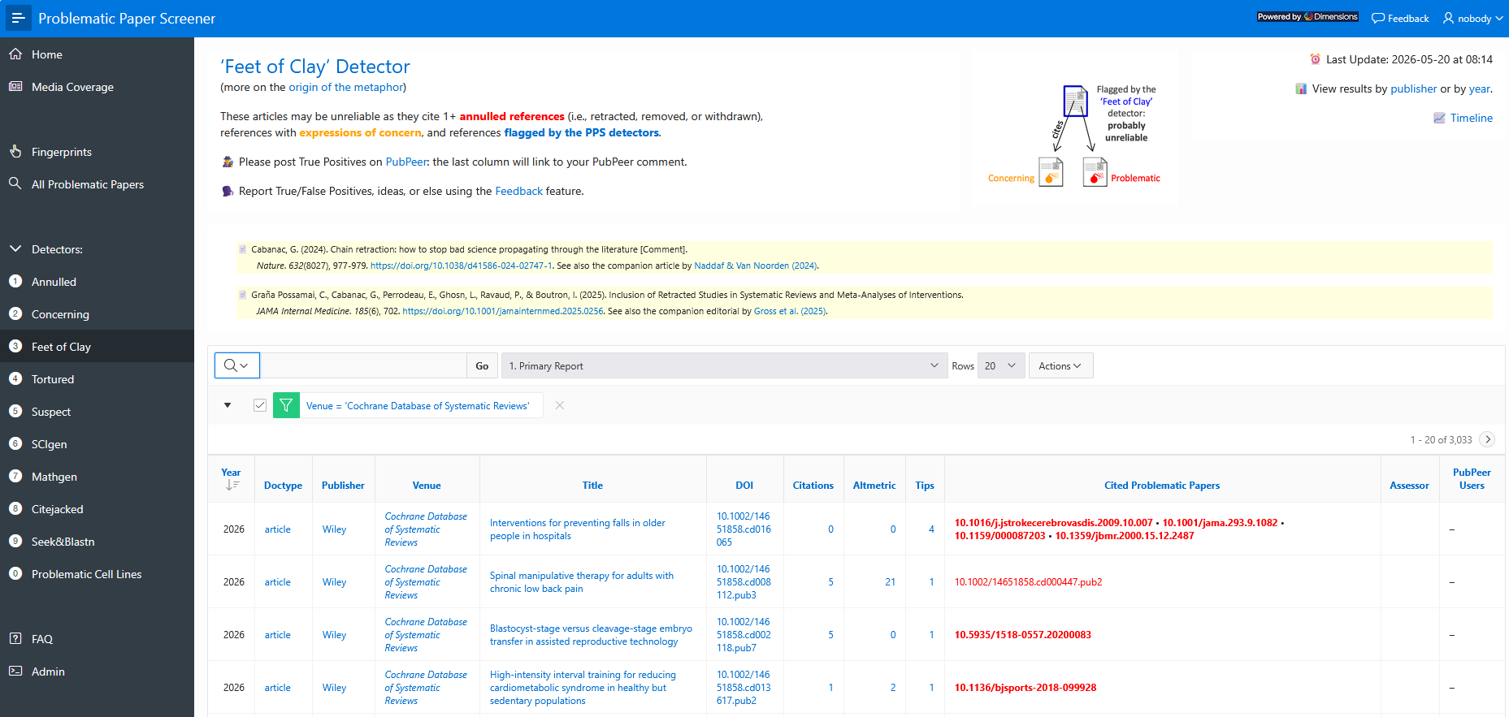
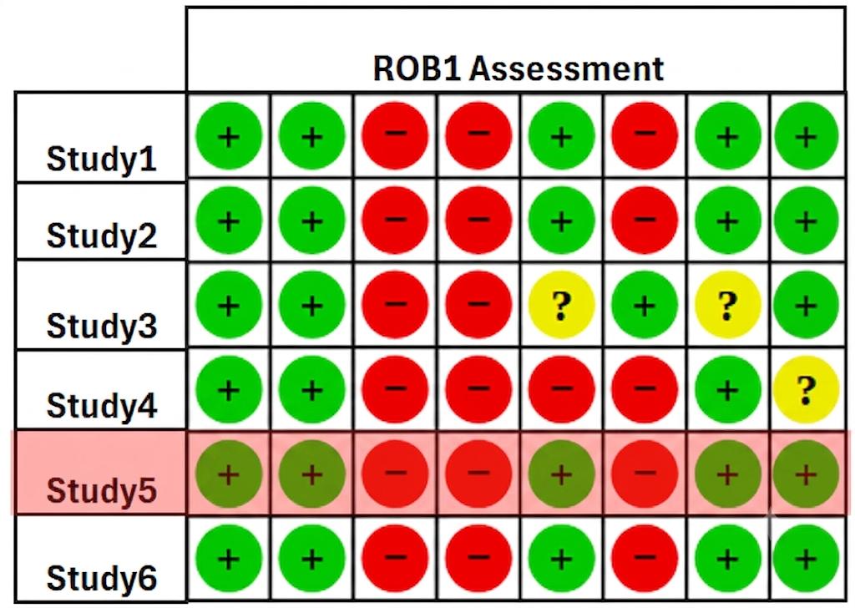

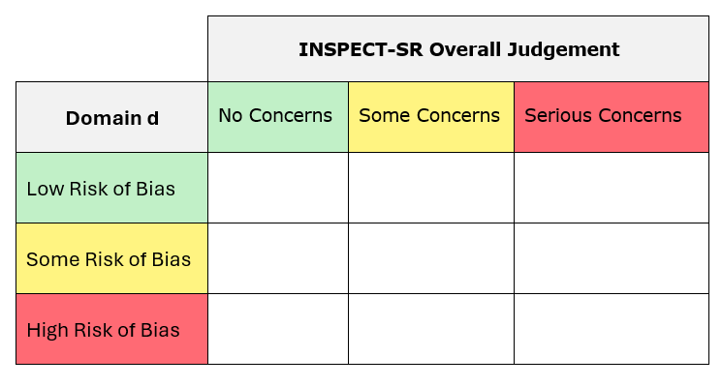
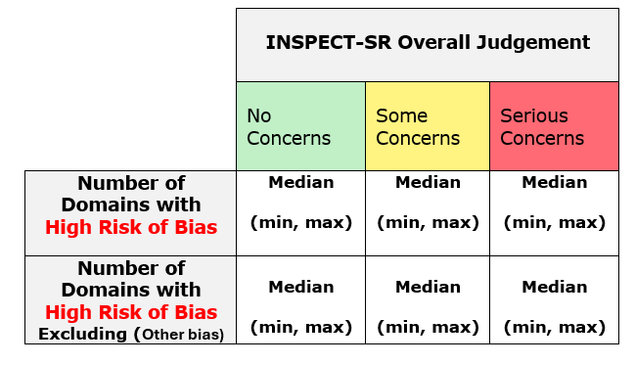
Can trustworthiness checks (INSPECT-SR) spot problematic trials before they are retracted? This study compares INSPECT-SR and risk-of-bias (RoB1) assessments in retracted trials to help ensure reviews use reliable evidence.
Protocol for a Meta-Research Study A Review of Risk of Bias and Trustworthiness Profiles of Retracted Trials in Cochrane Reviews.
Background
Systematic reviews are commonly used to guide clinical decisions; unfortunately, they sometimes include trials that are later found to be unreliable and retracted, leading to misleading conclusions.
RCTs included in systematic reviews are routinely appraised using risk-of-bias tools, such as the Cochrane-endorsed tool RoB1. Consequently, the Cochrane Handbook for systematic reviews suggests that risk-of-bias assessments should be used to determine eligibility for primary analyses or to stratify trials by risk of bias.
INSPECT-SR is a Cochrane-endorsed tool that assesses the trustworthiness of RCTs and recommends excluding studies with serious trustworthiness concerns from systematic reviews. However, we still don’t know if the tool will help avoid the use of trials that would end up retracted in the future. Moreover, if the retracted studies are at high risk of bias, and the Cochrane guidance is followed, then applying the Inspect SR might be redundant; it is therefore interesting as well to look at the relationship between the two assessments.
Methodology
1- Selection of the studies
Retracted RCTs with a RoB1 assessment will be identified from Cochrane reviews using the Feet of Clay Detector. Reviews will be screened from most recent to oldest, and only trials included in the review study list (not background citations) will be eligible. One eligible trial per review will be selected, and each trial may be included only once.
2- Sample Size
Sample size (n = 50) was determined by feasibility, as INSPECT-SR assessments are time-intensive (~45 minutes per trial). Assuming 70% of retracted trials have serious INSPECT-SR concerns, this sample size provides a 95% confidence interval of approximately ±13%.
3- Assessments of the studies
Risk-of-bias assessments will be extracted from the Cochrane reviews. Trustworthiness will be independently assessed by two reviewers using INSPECT-SR, with disagreements resolved through discussion or a third reviewer. Because all included trials are already retracted, the INSPECT-SR retraction check will be omitted. Assessments will use only information that was available at the time the Cochrane review was published.
4- Analysis Plan
INSPECT-SR and RoB1 judgements will be summarised using descriptive statistics. We will examine the proportion of trials with serious INSPECT-SR concerns (95% CI), the number of RoB1 domains rated as high risk across INSPECT-SR categories, and the agreement between INSPECT-SR and RoB1 assessments using cross-tabulations.
Objectives
Primary objective:
To evaluate whether INSPECT-SR would identify studies retracted for trustworthiness reasons.
Secondary objective:
To examine the relationship between risk-of-bias and trustworthiness judgments in retracted RCTs using RoB1 and INSPECT-SR.
To view the repository where this poster,
and the Protocol draft is held, visit
https://tinyurl.com/y6uemtrz
or scan this QR code →
Trustworthiness assessment using the INSPECT-SR
Analysis using both RoB1 and INSPECT-SR assessments
Identifying Cochrane Review with potential retracted studies using the Feet of Clay Detector available on the Problematic Paper Screener website, developed by Guillaume Cabanac.
Identifying retracted RCTs in the studies list of the Cochrane review
RoB1 assessment collected from the review
Wilfried Lakena¹, Alison Avenell², Neil Oconnell³, Lisa Bero⁴, Jack Wilkinson¹, Sarah Rhodes¹
1- Centre for Biostatistics, Manchester Academic Health Science Centre, Faculty of Biology, Medicine, and Health, University of Manchester, Manchester, UK
2-Aberdeen Centre for Evaluation, Institute of Applied Health Sciences, University of Aberdeen, Foresterhill, Aberdeen, UK
3-Centre for Health and Wellbeing Across the Lifecourse, Department of Health Sciences, Brunel University of London, Uxbridge, UK
4-Institute for Health Policy Studies, University of California, San Francisco, California, USA

